Slide 1
Chess Neural Network Using AI
Team Members:
1. Nikhil Thapa
2. Bandu Sakhare
3. Prajwal Jadhav
4. Rohan Mandhare
Guided by:
Prof. Shwetkranti Taware

Slide 2
Agenda
Aim
Literature Survey
Motivation
Objectives
Proposed System
H/W and S/W to be used and Overall Cost requirement
Planning and Schedulling of Project(Gantt Chart)
Risk Involved
Social Aspects
Conclusion
References

Slide 3
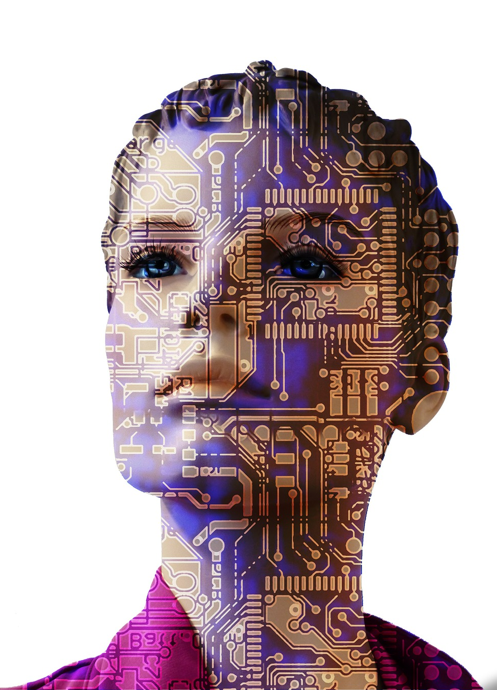
Aim
The aim is to create a Chess Neural Network Artificial Intelligence.
To develop a program/software that can train Human Mind to increase his/her IQ Level
To search the position deeply enough beyond the abilities of humans.
To be able to help Professional Players to improve their game even further.

Slide 4
Literature Survey
Sr. No. | Title of Paper | Year | Author | Key Points | Gap identified
1 | An Evolutionary Game Tree Search Algorithm of Military Chess Game Based on Neural Value Network | 2020 | Tingzhen Liu College of Information Science and Engineering, Shenyang University of Technology, Shenyang Derun Ai College of Information Science and Engineering, Shenyang University of Technology, Shenyang Yimin Ma College of Information Science and Engineering, Shenyang University of Technology, Shenyang | military chess has high requirements for the design of the situation evaluation algorithm and the search algorithm. | To create a simulation of opponent using maching learning to help professionals to study better
2 | A Middle Game Search Algorithm Applicable to Low-Cost Personal Computer for Go | 2019 | Xiali Li School of Information Engineering, Minzu University of China, Beijing, China Zhengyu Lv School of Information Engineering, Minzu University of China, Beijing, China Xiaochuan Zhang School of Artificial Intelligence, Chongqing University of Technology, Chongqing, China | Go game is generally divided into layout, mid-game and final stage, and the mid- game has a great influence on the outcome. | considerably shortens training time and requires almost no human knowledge should be conducted which are helpful to to better understand.
3 | Deep learning advancements: closing the gap | 2019 | A. Stipić CITUS, Zagreb, Croatia T. Bronzin CITUS, Zagreb, Croatia B. Prole CITUS, Zagreb, Croatia | AI systems have been tested in chess and the same has been done to demonstrate the power of AlphaZero. | To create a simulation of opponent using maching learning to help professionals to study better

Slide 5
Sr.No. | Title of Paper | Year | Author | Key Points | Gap identified
4 | A New AI Open Problem: WUGU Chess | 2019 | Chunxiao Ren High-Tech Development Zone, Shandong Province Science and Technology Exchange Center, No. 607 Shunshua Rd, Jinan, P.R. China. Yuxiao Wu High-Tech Development Zone, Shandong Province Science and Technology Exchange Center, No. 1768 Xinluo Rd, Jinan, P.R. China | Game is an early research topic in the field of AI, and it is also a very active and representative research direction. | To create a simulation of opponent using maching learning to help professionals to study better.
5 | Application of Neurological Networks in an AI for Chess Game | 2020 | Vinay Kumar Amity University Greater Noida Campus. Divya Singh Amity University Greater Noida Campus Garima Bhardwaj Amity University Greater Noida Campus | To create chess game that can learn using image modulation techniques and play against a real human. | To create a simulation of opponent using maching learning to help professionals to study better.

Slide 6
Motivations
The use of Computers is increasing rapidly in the field of Chess to scan the most difficult problems using sophisticated algorithms.
Computers have played an important and vital role in increasing the strength of a chess player.
Advanced Technology improvements in chess will completely change the way we look into the game of Chess.
With more than 10⁸⁰ moves possible in chess, only one is the best move. The job of the AI is to find that move.

Slide 7
Objectives
To create an AI to scan millions of positions to find the best move.
To create an AI that can self-adjust according to Human Thinking. The more games we feed, the better AI adjusts itself to Human Thinking.
To help a player to increase his mental strength or IQ level.
Professionals can improve their game by analyzing mistakes and blunders.
To change the game of chess of how it was observed a few years back.

Slide 8
Proposed System
Evaluation Function
Evaluation Function calculates the material value and piece placement score (max scope).
It then returns the value to the evaluated position.

Slide 9
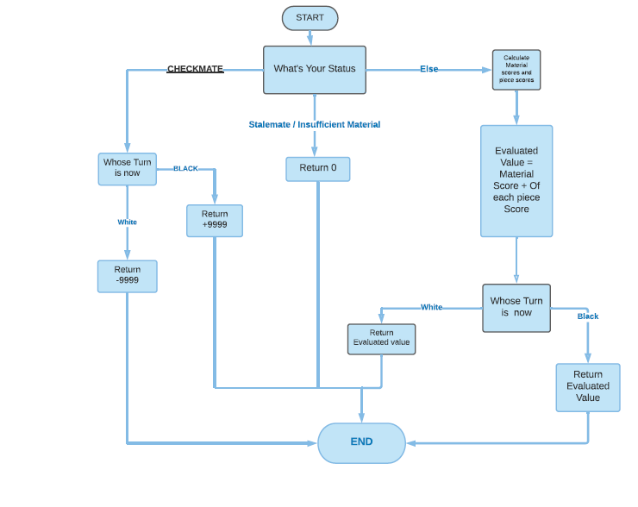
UML DIAGRAM :

Slide 10
Algorithms
Pure Minimax Search
+ Alpha-beta Pruning
Move Ordering
Naïve Pattern Searching
Greedy Algorithm
Zobrist Hashing

Slide 11
Algorithms
Pure Minimax Search is based on a recursive algorithm for choosing the next move.
A value is associated with each position of the game is calculated by the Evaluation Function.
According to the minimax algorithm, a tree of all possible moves is generated until the depth is defined.
At the depth, millions of positions are scanned and each position is given an evaluation.
Based on the final evaluation, the evaluation of the upper node is defined.
The Upper node is given a number based on the best possible reply of the opponent and the best possible choice.

Slide 12
Pure Minimax Search
6
9
-2
4
-6
0
-8
7
-9
4
2
6

Slide 13
+Alpha-beta Pruning is an optimization that reduces the search and the scan time.
6
-2
4
-6
0
-8
4
2
6

Slide 14
Naïve Pattern Searching is used for searching the position of pieces from the Forsyth-Edwards Notation (FEN) string
Zobrist Hashing is used to generate the FEN String and it is stored in the transposition table. If the same position is encountered again, we simply retrieve the stored value from the transposition table.
Move Ordering is an optimization to eliminate the searching of moves with the same positions that occur through transpositions.
Greedy Algorithm is used to compare the evaluation of all the next possible moves and it gives the upper node a number based on the best possible choice or best possible reply.

Slide 15
H/W and S/W to be used & Cost Requirement:
Software | Hardware
Unity | Intel i3 Processor / Ryzen 3
C# | 4GB Ram
Python | Laptop / PC
PGN Viewer | Mouse
Cost Required : Open Source Project

Slide 16
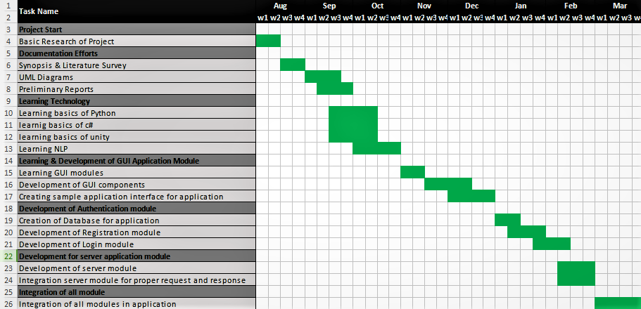
Schedule Of Project :

Slide 17
Risk Involved
Chess is a board game. Playing, analyzing, and spending too much time in front of a computer screen (Chess AI) can cause eye problems and mental health.
Playing and losing against a Chess AI frequently can affect the player both emotionally & psychologically.
Simulation of the opponent using a Chess AI doesn’t guarantee a 100% chance of winning against the opponent in a real game. You may even lose a game if the opponent’s recent data is not fed correctly.

Slide 18
Social Aspect
Chess AI is beneficial as people will be able to increase their mental IQ when they play and practice against the AI.
Top players around the world can use Chess AI to understand the game of their opponents much better.
Anyone can play virtually against their favorite chess players by feeding their games into the Chess AI. Chess AI will simulate according to their playing style.

Slide 19
Conclusion
Chess is a game with infinite possibilities. And in some positions, it becomes almost impossible for Humans to calculate what’s the current scenario.
With the growth of technology & Artificial Intelligence, computers and AI can do extremely difficult calculations that can unlock the ultimate beauty of this Game.
Chess Neural Network AI can scan millions of positions to generate the best variation out of millions of possibilities. It can calculate beyond the abilities of a human.

Slide 20
References
[1] Murray Campbell, A. Joseph Hoane Jr., Feng-hsiung Hsu, “Deep Blue”, IBM, August 1, 2001.
[2] Laurence Fausett, “Fundamentals of Neural Networks Architectures, Algorithms, and Applications”, Dorling Kindersley Pvt. Ltd., South Asia, 2008
[3] Alexandru Godescu, “An information theoretic analysis of decision in computer chess” ETH Zurich December 13, 2011
[4] Diwas Sharma, Udit Kr. Chakraborty, Artificial Neural Network based adaptive chess playing machine. International Journal of Advance Research in Computer Science, Vol 4 no. 4, March-April 2013.

